Slide 1
Multimedia Computing
By
Minhaz Uddin Ahmed, PhD
Department of Computer Engineering
Inha University Tashkent.
Email: minhaz.ahmed@gmail.com

Slide 2
Content
Signal to Noise Ratio (SNR)
Signal to quantization Noise Ratio (SQNR)
Audio Filtering
Audio Quality vs Data rate
Synthetic sounds
Midi: Musical Instrument Digital Interface
Hardware Aspect of MIDI
Coding of Audio
PCM code modulation

Slide 3
SAMPLING THEOREM AND ALIASING
Aliasing in the Temporal Domain
Examples of temporal aliasing can be seen in western movies, by observing the motion of stagecoach wheels. As the stagecoach starts to move, we observe its wheels rotating in the expected forward direction. As the stagecoach speeds up, we see that the wheels appear to rotate in the opposite direction to the initial one.
This occurs because the movie camera has under sampled the wheels’ motion
Notes:
https://www.youtube.com/watch?v=B8EMI3_0TO0
https://www.youtube.com/watch?v=Ddxf2YESIgw
https://www.youtube.com/watch?v=UaKho805vCE

Slide 4
Signal to Noise Ratio (SNR)
In any analog system, random fluctuations produce noise added to the signal, and the measured voltage is thus incorrect. The ratio of the power of the correct signal to the noise is called the signal-to-noise ratio (SNR). Therefore, the SNR is a measure of the quality of the signal. The SNR is usually measured in decibels (dB), where 1 dB is a tenth of a bel. The SNR value, in units of dB, is defined in terms of base-10 logarithms of squared .
Bel : a unit used for measuring sound intensity, equal to 10 decibels

Slide 5
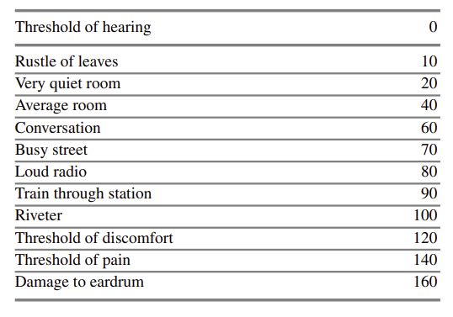
Signal to Noise Ratio (SNR)
Table: 1 Magnitudes of common sounds, in decibels

Slide 6

Signal to Noise Ratio (SNR)
The power in a signal is proportional to the square of the voltage. For example, if the signal voltage Vsignal is 10 times the noise, the SNR is 20 × log10(10) = 20 dB
The term “decibels” as applied to sounds in our environment usually is in comparison to a just-audible sound with frequency 1 kHz. The levels of sound we hear around us are described in terms of decibels, as a ratio to the quietest sound we are capable of hearing

Slide 7
Signal-to-Quantization-Noise Ratio (SQNR)
For digital signals, we must take into account the fact that only quantized values are stored. For a digital audio signal, the precision of each sample is determined by the number of bits per sample, typically 8 or 16.
Aside from any noise that may have been present in the original analog signal, additional error results from quantization. That is, if voltages are in the range of 0 to 1 but we have only 8 bits in which to store values, we effectively force all continuous values of voltage into only 256 different values.
Inevitably, this introduces a roundoff error. Although it is not really “noise,” it is called quantization noise (or quantization error). The association with the concept of noise is that such errors will essentially occur randomly from sample to sample.
Notes:
The difference between the original signal and the reconstructed signal is the quantization error

Slide 8
Signal-to-Quantization-Noise Ratio (SQNR)
The quality of the quantization is characterized by the signal-to-quantization noise ratio (SQNR). Quantization noise is defined as the difference between the value of the analog signal, for the particular sampling time, and the nearest quantization interval value. At most, this error can be as much as half of the interval
The SQNR reflects the relationship between the maximum nominal signal strength and the quantization error (also known as quantization noise) introduced in the analog-to-digital conversion.

Slide 9

Signal-to-Quantization-Noise Ratio (SQNR)
In other words, each bit adds about 6 dB of resolution, so 16 bits provide a maximum SQNR of 96 dB. we assume that the input signal is sinusoidal, that quantization error is statistically independent, and that its magnitude is uniformly distributed between 0 and half the interval
SQNR = 6.02N + 1.76(dB)
Since larger is better, this shows that a more realistic approximation gives a better characterization number for the quality of a system.

Slide 10
Audio Filtering
The audio signal is filtered to remove unwanted frequencies. The frequencies kept depend on the application. For speech, typically from 50 Hz to 10 kHz is retained. Other frequencies are blocked.
by a bandpass filter, also called a band-limiting filter, which screens out lower and higher frequencies. An audio music signal will typically contain from about 20 Hz up to 20 kHz. So the bandpass filter for music will screen out frequencies outside this range. At the DA converter end, even though we have removed high frequencies that are likely just noise in any event, they reappear in the output. The reason is that because of sampling and then quantization. Therefore, at the decoder side, a low-pass filter is used after the DA circuit, making use of the same cutoff as at the high-frequency end of the coder’s bandpass filter.

Slide 11
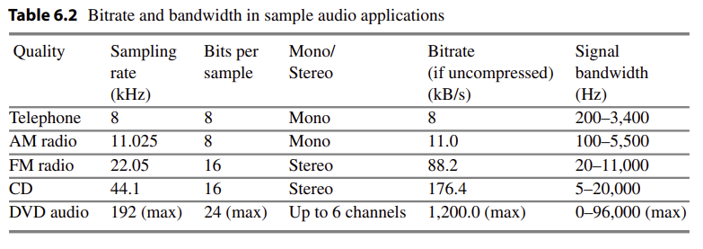
Audio Quality Versus Data Rate
The uncompressed data rate increases as more bits are used for quantization. Stereo information, as opposed to mono, doubles the bitrate needed to transmit a digital audio signal. Table 6.2 shows how audio quality is related to bitrate and bandwidth.

Slide 12
Audio Quality Versus Data Rate
So for analog devices, the bandwidth was expressed in the frequency unit, called Hertz (Hz), which is cycles per second.
In contrast, in Computer Networking, the term bandwidth refers to the data rate (bps) that the network or transmission link can deliver.
The standard sampling frequencies used in audio are 5.0125 kHz, 11.025 kHz, 22.05 kHz, and 44.1 kHz, with some exceptions, and these frequencies are supported by most sound cards.

Slide 13
Synthetic Sounds
Digitized sound must still be converted to analog, for us to hear it. There are two fundamentally different approaches to handling stored sampled audio. The first is termed FM, for frequency modulation. The second is called Wave Table, or just Wave, sound.
FM is short for frequency modulation, which refers to the means of encoding the audio signal on the carrier frequency. FM full power, low power, translator and booster stations operate in the 88 – 108 MHz band. There are many classes of radio stations.

Slide 14
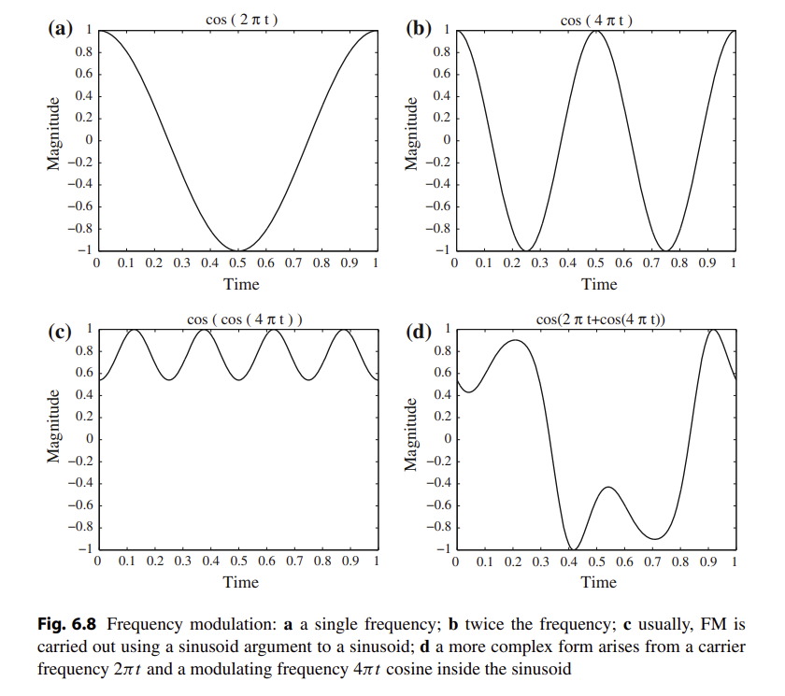
Synthetic Sounds

Slide 15
MIDI: Musical Instrument Digital Interface
MIDI, which dates from the early 1980s, is an acronym that stands for Musical Instrument Digital Interface. It forms a protocol adopted by the electronic music industry that enables computers, synthesizers, keyboards, and other musical devices to communicate with each other.
The MIDI standard is supported by most synthesizers, so sounds created on one can be played and manipulated on another and sound reasonably close. Computers must have a special MIDI interface, but this is incorporated into most sound cards. The sound card must also have both DA and AD converters.

Slide 16
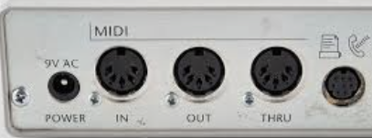
MIDI: Musical Instrument Digital Interface
MIDI is a scripting language—it codes “events” that stand for the production of certain sounds. Therefore, MIDI files are generally very small. For example, a MIDI event might include values for the pitch of a single note, its volume, and what instrument sound to play.
Role of MIDI: MIDI makes music notes , so is useful for inventing, editing, and exchanging musical ideas that can be encapsulated as notes., MIDI is aimed at music, which can then be altered as the “user” wishes. Since MIDI is intimately related to music composition programs, MIDI is a very useful vehicle for music education.

Slide 17
MIDI: Musical Instrument Digital Interface
MIDI-based musical communication is the availability of a single MIDI instrument to control other MIDI instruments, allowing a master slave relationship: the other MIDI instruments must play the same music, in part, as the master instrument, thus allowing interesting music. For example, suppose a keyboard mimics a traditional instrument well, but generates poor actual sound with a builtin synthesizer. Then “daisy-chaining” to a different synthesizer, one that generates excellent sound, may make an overall good combination. Since MIDI comes with a built-in timecode, the master’s clock can be used to synchronize all the slave timecodes, making for more exact synchronization.
A so-called “sequencer-sampler” can be used to reorder and manipulate sets of digital-audio samples and/or sequences of MIDI. In a Digital Audio Workstation, running ProTools for example, multitrack recording is possible, either sequentially or concurrently. For example, one could simultaneously record 8 vocal tracks and 8 instrument tracks.

Slide 18
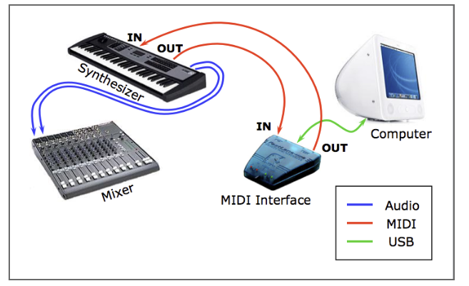
MIDI: Musical Instrument Digital Interface
MIDI Concepts
Music is organized into tracks in a sequencer. Each track can be turned on or off on recording or playing back. Usually, a particular instrument is associated with a MIDI channel. MIDI channels are used to separate messages. There are 16 channels, numbered from 0 to 15. The channel forms the last four bits (the least significant bits) of that do refer to the channel. The idea is that each channel is associated with a particular instrument—for example, channel 1 is the piano, channel 10 is the drums. Nevertheless, you can switch instruments midstream, if desired, and associate another instrument with any channel.

Slide 19
MIDI: Musical Instrument Digital Interface
Along with channel messages (which include a channel number), several other types of messages are sent, such as a general message for all instruments indicating a change in tuning or timing; these are called system messages.
The way a synthetic musical instrument responds to a MIDI message is usually by simply ignoring any “play sound” message that is not for its channel. If several messages are for its channel, say several simultaneous notes being played on a piano, then the instrument responds, provided it is multi-voice—that is, can play more than a single note at once

Slide 20
MIDI: Musical Instrument Digital Interface
MIDI Terminology
A synthesizer was, and still can be, a stand-alone sound generator that can vary pitch, loudness, and tone color. A good (musician’s) synthesizer often has a microprocessor, keyboard, control panels, memory, and so on. However, inexpensive synthesizers are also included on PC sound cards. Units that generate sound are referred to as tone modules or sound modules.
A sequencer started off as a special hardware device for storing and editing a sequence of musical events, in the form of MIDI data. Now it is more often a software music editor on the computer.

Slide 21
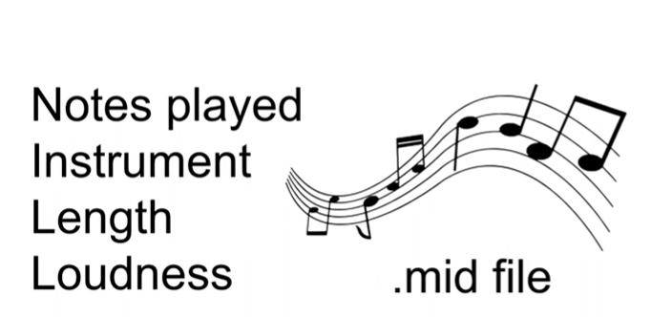
MIDI: Musical Instrument Digital Interface
A MIDI keyboard produces no sound, instead generating sequences of MIDI instructions, called MIDI messages(but can also include a synthesizer for generating sound). MIDI messages are rather like assembler code and usually consist of just a few bytes. Stored as a sequence of MIDI messages, you might have 3 minutes of music, say, stored in only 3 kB. In comparison, a wave table file (WAV) stores 1 minute of music in about 10 MB.
we are trying to emulate—for example, a piano as opposed to a violin. It is the quality of the sound. An instrument (or sound card) that is multi-timbral is capable of playing many different sounds at the same time, (e.g., piano, brass, drums)

Slide 22
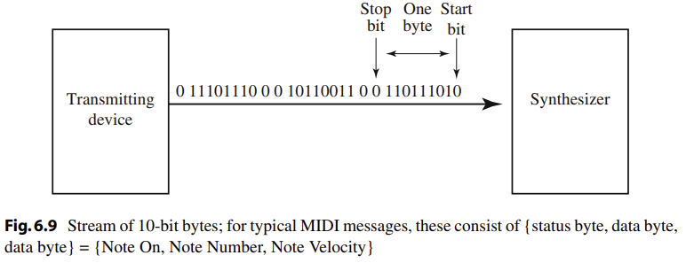
MIDI: Musical Instrument Digital Interface
the term “voice”, while sometimes used by musicians to mean the same thing as timbre, is used in MIDI to mean every different timbre and pitch that the tone module can produce at the same time. Synthesizers can have many (typically 16, 32, 64, 256, etc.) voices. Each voice works independently and simultaneously to produce sounds of different timbre and pitch.

Slide 23
MIDI: Musical Instrument Digital Interface
The term polyphony refers to the number of voices that can be produced at the same time. So a typical tone module may be able to produce “64 voices of polyphony” (64 different notes at once) and be “16-part multi-timbral” (can produce sounds like 16 different instruments at once).

Slide 24
MIDI: Musical Instrument Digital Interface
MIDI Specifics
How different timbres are produced digitally is by using a patch, which is the set of control settings that define a particular timbre. Patches are often organized into databases, called banks. For true aficionados, software patch editors are available.
A standard mapping specifying just what instruments (patches) will be associated with what channels has been agreed on and is called General MIDI. In General MIDI, there are 128 patches associated with standard instruments, and channel 10 is reserved for percussion instruments

Slide 25
MIDI: Musical Instrument Digital Interface
The data in a MIDI status byte is between 128 and 255; each of the data bytes is between 0 and 127. Actual MIDI bytes are 8 bit, plus a 0 start and stop bit, making them 10-bit “bytes”. Figure 6.9 shows the MIDI data stream.
A MIDI device often is capable of programmability, which means it has filters available for changing the bass and treble response and can also change the “envelope” describing how the amplitude of a sound changes over time. Figure 6.10 shows a model of a digital instrument’s response to Note On/Note Off messages.

Slide 26
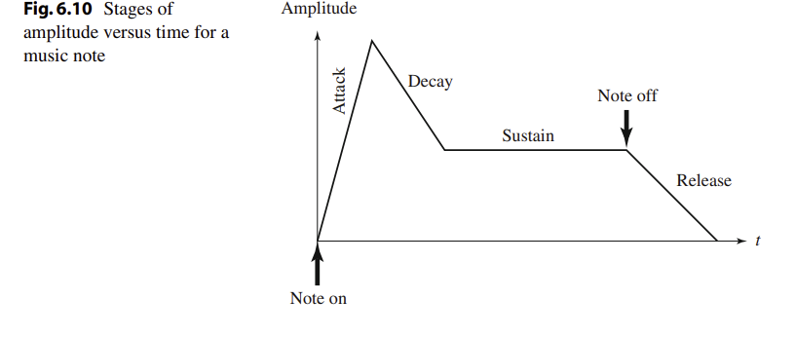
MIDI: Musical Instrument Digital Interface

Slide 27
MIDI: Musical Instrument Digital Interface
MIDI sequencers (editors) allow you to work with standard music notation or get right into the data, if desired. MIDI files can also store wave table data. The advantage of wave-table data (WAV files) is that it much more precisely stores the exact sound of an instrument. A sampler is used to sample the audio data—for example, a “drum machine” always stores wave table data of real drums. So one could have a music editor using MIDI on one track plus digital audio such as vocals, say, on another track

Slide 28
MIDI: Musical Instrument Digital Interface
MIDI provides a full messaging protocol that can be used for whatever one likes, for example for controlling lights in a theater. There is a MIDI message for sending any kind and any number of bytes, which can then be used as the programmer desire
Sequencers employ several techniques for producing more music from what is actually available. For example, looping over (repeating) a few bars can be more or less convincing. Volume can be easily controlled over time—this is called time varying amplitude modulation. More interestingly, sequencers can also accomplish time compression or expansion with no pitch change.

Slide 29
MIDI: Musical Instrument Digital Interface
While it is possible to change the pitch of a sampled instrument, if the key change is large, the resulting sound begins to sound displeasing. For this reason, samplers employ multisampling. A sound is recorded using several bandpass filters, and the resulting recordings are assigned to different keyboard keys. This makes frequency shifting for a change of key more reliable, since less shift is involved for each note

Slide 30
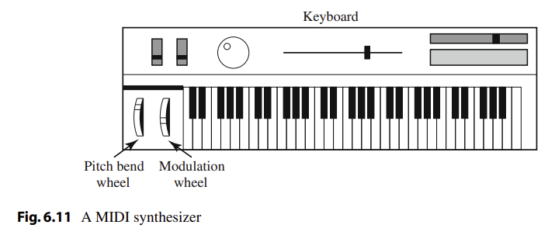
MIDI: Musical Instrument Digital Interface
MIDI Machine Control (MMC) is a subset of the MIDI specification that can be used for controlling recording equipment, e.g. multitrack recorders. The most common use of this facility is to effectively press “Play” on a remote device. An example usage would be if a MIDI device has a poor timer, then the master could activate it at just the right time. In general, MIDI can be used for controlling and synchronizing musical instrument synthesizers and recording equipment, and even control lighting

Slide 31
Hardware Aspects of MIDI
The MIDI hardware setup consists of a 31.25 kbps serial connection, with the 10-bit bytes including a 0 start and stop bit. Usually, MIDI-capable units are either input devices or output devices, not both.
Figure 6.11 shows a traditional synthesizer. The modulation wheel adds vibrato. Pitch bend alters the frequency, much like pulling a guitar string over slightly.
The physical MIDI ports consist of 5-pin connectors labeled IN and OUT and there can also be a third connector, THRU. This last data channel simply copies data entering the IN channel. MIDI communication is half-duplex. MIDI IN is the connector via which the device receives all MIDI data. MIDI OUT is the connector through which the device transmits all the MIDI data it generates itself.

Slide 32
Hardware Aspects of MIDI
Figure 6.12 shows a typical MIDI sequencer setup. Here, the MIDI OUT of the keyboard is connected to the MIDI IN of a synthesizer and then THRU to each of the additional sound modules. During recording, a keyboard-equipped synthesizer sends MIDI messages to a sequencer, which records them. During playback, messages are sent from the sequencer to all the sound modules and the synthesizer, which play the music.

Slide 33
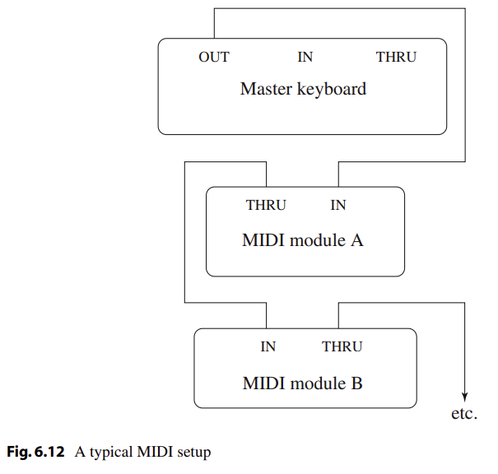
Hardware Aspects of MIDI

Slide 34
MIDI Message Transmission
The 31.25 kbps data rate is actually quite restrictive. To initiate playing a note, a 3-byte message is sent . If my hands are playing chords with all ten fingers, then a single crashing chord will take ten notes at 30 bits each, requiring transmission of 300 bits. At 31.25 kbps transmission of this chord will take about 0.01 sec, at a speed of about 0.001 seconds per note—and all this not counting the additional messages we’ll have to send to turn off these ten notes.
using the pitch bend and modulation wheels in a synthesizer could generate many messages as well.

Slide 35
Structure of MIDI Messages
MIDI messages can be classified into two types
Channel Messages. A channel message can have up to 3 bytes; the first is the status byte and has its most significant bit set to 1. The four low order bits identify which of the 16 possible channels this message belongs to, with the three remaining bits holding the message. For a data byte, the most significant bit is set to zero.
Voice Messages. This type of channel message controls a voice—that is, sends information specifying which note to play or to turn off—and encodes key pressure. Voice messages are also used to specify controller effects, such as sustain, vibrato, tremolo, and the pitch wheel. Table 6.3 lists these operations.

Slide 36
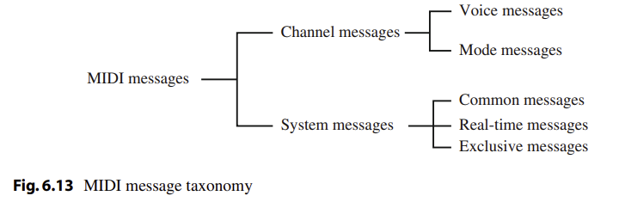
Structure of MIDI Messages

Slide 37
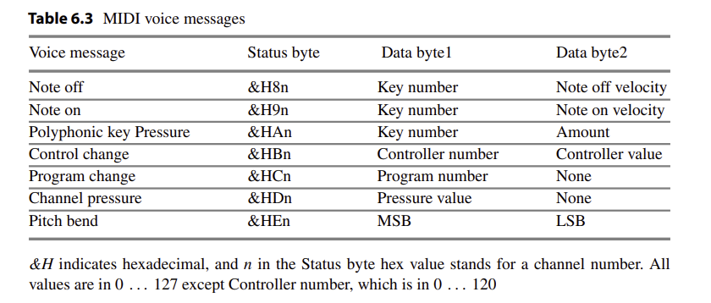
Structure of MIDI Messages

Slide 38
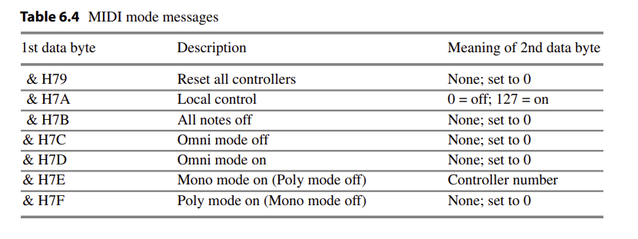
Structure of MIDI Messages

Slide 39
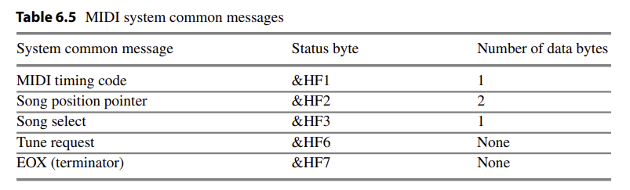
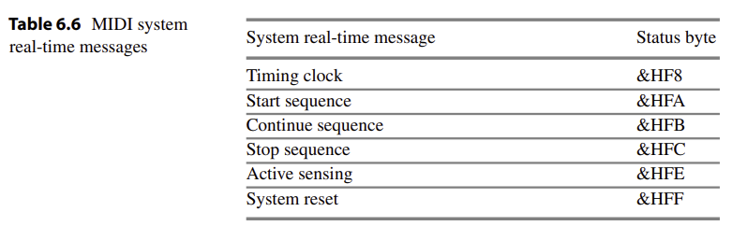
Structure of MIDI Messages

Slide 40
General MIDI
For MIDI music to sound more or less the same on every machine, we would at least like to have the same patch numbers associated with the same instruments—for example, patch 1 should always be a piano, not a flugelhorn. A standard percussion map also specifies 47 percussion sounds. Where a “note” appears on a musical score determines just what percussion element is being struck. MIDI device must support all 16 channels; must be multi-timbral (i.e., each channel can play a different instrument/program); must be polyphonic (i.e., each channel is able to play many voices); and must have a minimum of 24 dynamically allocated voices.

Slide 41
MIDI-to-WAV Conversion
early versions of Adobe Premiere, cannot include MIDI files—instead, they insist on WAV format files. Various shareware programs can approximate a reasonable conversion between these formats. The programs essentially consist of large lookup files that try to do a reasonable job of substituting predefined or shifted WAV output for some MIDI messages, with inconsistent success.

Slide 42
Coding of Audio
Quantization and transformation of data are collectively known as coding of the data. For audio, the µ-law technique for companding (reduce the SNR of (a signal) using a compander.) audio signals is usually combined with a simple algorithm that exploits the temporal redundancy present in audio signals.

Slide 43
PCM in general
Every compression scheme has three stages:
1. Transformation. The input data is transformed to a new representation that is easier or more efficient to compress. For example, in Predictive Coding, we predict the next signal from previous ones and transmit the prediction error.
2. Loss. We may introduce loss of information. Quantization is the main lossy step. Here, we use a limited number of reconstruction levels fewer than in the original signal. Therefore, quantization necessitates some loss of information.
3. Coding. Here, we assign a codeword (thus forming a binary bitstream) to each output level or symbol. This could be a fixed-length code or a variable-length code, such as Huffman coding

Slide 44
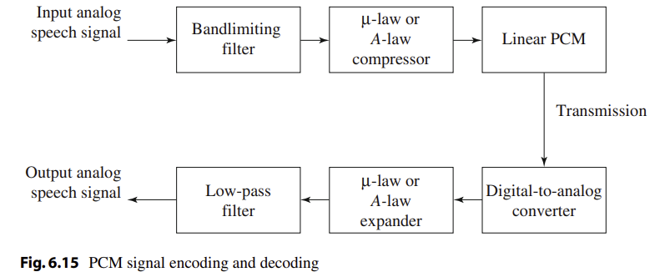
PCM in general

Slide 45
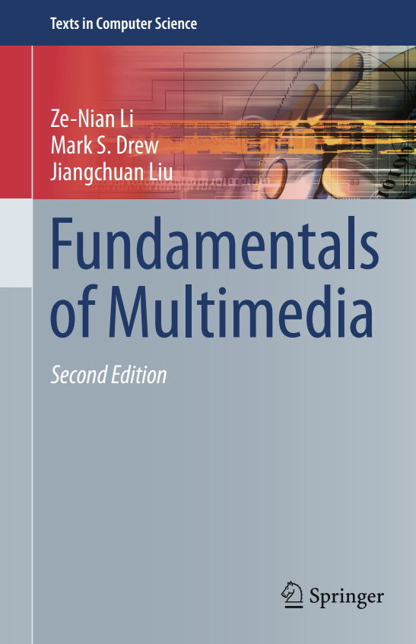
Reference
Chapter 6

Slide 46

Question

Slide 47

Thank you

